Slide 1
Data and Feature Engineering

Slide 2
Know Your Challenge
From Business Problem to Data

Slide 3
HR Employee Attrition Dataset
Understanding Our Business Problem
Identify the key factors contributing to employee turnover to help predict attrition and reduce recruitment and training costs.
Feature Categories
Business Context
Demographics: Age, gender, marital status, education
Job-related: Department, job role, job level, years at company
Dataset Overview
1,470 employee records with 35 features, used to predict Attrition (Yes/No)
Compensation: Monthly income, percent salary hike, stock option level
Satisfaction: Job satisfaction, environment satisfaction, work life balance

Slide 4






What We'll Build Today
End-to-End Data Preprocessing Pipeline
Load
Clean
Explore
Understand structure
Fix quality issues
Find patterns
Split
Transform
Visualise
Train and test
Scale and encode
Tell the story
Have a complete, reusable pre-processing workflow by session end

Slide 5
Trust Your Data
From Messy to Clean

Slide 6
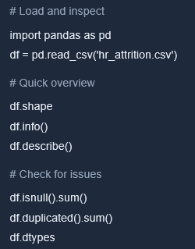
Live Demo: Data Quality Assessment
First look at the data
What are we looking for?
Missing values: Nan, null, blank cells
Duplicates: Repeated rows
Wrong data types: Numbers as strings
Outliers: Extreme values
Inconsistencies: "Male" vs "M" vs "male"

Slide 7
Identifying Data Issues
What We Found in Our HR Dataset
Missing values
Duplicates
Monthly income: 45 nulls
12 duplicate rows found
Total working years: 32 nulls
Same employee recorded
Num companies worked: 19 nulls
Multiple times
Strategy : Imputation
Strategy: Drop duplicates
Outliers
Monthly income: 8 extreme
Years at company: 5 extreme
Detected via IQR method
Strategy: Cap or investigate

Slide 8
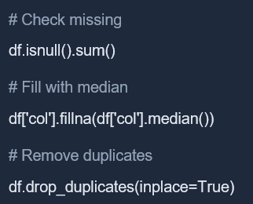
Activity: Fix the Messy Data
Time: 10 minutes
Your Tasks
Helpful Code
Load the dataset and check its shape
01
Identify columns with missing values
02
Fill missing numerical values with median
03
Remove duplicate rows
04
Verify: Are there still missing values?
Raise your hand if you need help
05

Slide 9
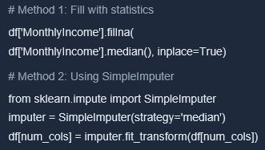

Live Demo: Handling Missing Values
When to Use What?
Mean
Identify normally distributed data with no outliers
Median
Detect skewed data or outliers
Mode
Recognise categorical variables
Forward/Backward Fill Time series data

Slide 10
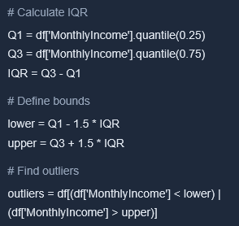

Live Demo: Outlier Detection — IQR Method
Treatment Options
Remove
Identify when outliers are data errors
Cap (Winsorise)
Replace with upper or lower bound
Transform
Apply log transform to reduce impact
Keep
Recognise when outliers are valid (e.g. CEO salary)

Slide 11
Find the Signal
From Numbers to Insights

Slide 12

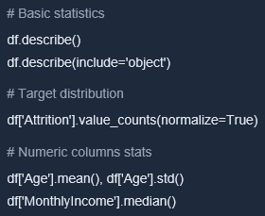
Live Demo: EDA Workflow
Exploring Our HR Dataset Systematically
Key Questions EDA Answers
What's the distribution of our target variable?
What's the range and spread of numeric features?
Which features are correlated with attrition?
Are there interesting segments in the data?
What stories does the data tell?
Notes:
Reference Image :
https://www.shutterstock.com/image-photo/data-analyst-working-business-analytics-planning-2287599799

Slide 13

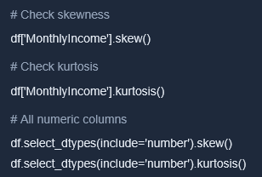
Live Demo: Distribution Analysis
How to Interpret
  = 0: Symmetric (normal) | > 0: Right-skewed (tail to right) | < 0: Left-skewed (tail to left)
Skewness
Kurtosis
  = 3: Normal distribution | > 3: Heavy tails (more outliers) | < 3: Light tails (fewer outliers)
Why it matters: Skewed data may need transformation before modelling
Notes:
Reference Image :
https://www.shutterstock.com/image-photo/online-documentation-database-document-management-system-2141549661

Slide 14
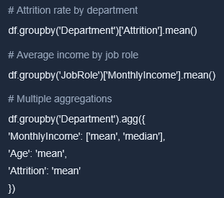
Live Demo: Group By for Segmented Insights
Example Insights
1. Identify sales as having the highest attrition
- 23% vs 14% company average
2. Observe managers staying longer
- Avg 8.2 years vs 5.1 overall
3. Note younger employees leaving more
- Under 30: 28% attrition rate
Use these insights to guide feature engineering decisions

Slide 15
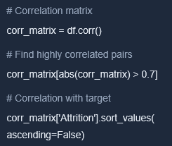

Live Demo: Correlation Analysis
Correlation Interpretation
+1.0 to +0.7: Strong Positive
  Observe as one increases, the other increases
+0.3 to -0.3: Weak/None
  Little to no linear relationship
-0.7 to -1.0: Strong Negative
Observe as one increases, the other decreases
Watch out: high correlation between features may indicate redundancy

Slide 16

Activity: Discover Patterns
Time: 8 minutes
Find 3 interesting patterns in the data
Your Mission
- Use group by, correlation or descriptive stats
Ideas to Explore
Share Your Findings
Which job roles have highest attrition?
Format:
1. What did you look at?
Is there a relationship between overtime and attrition?
2. What did you find?
3. Why might this matter for prediction?
How does satisfaction score vary by department?
Be ready to share one finding with
the class

Slide 17
Make It Clear
From Stats to Visuals

Slide 18
Visualisation Toolkit
Matplotlib + Seaborn Quick Reference
Univariate (1 variable)
Bivariate (2 variables)
Histogram: Distribution of numeric
data
Scatter Plot: Relationship between 2 numerics
Box Plot: Spread, quartiles, outliers
Bar Chart: Compare across categories
Box Plot (grouped): Distribution by category
Count Plot: Frequency of categories
Multivariate (many)
Heatmap: Correlation matrix visual
Pair Plot: All pairwise relationships
FacetGrid: Small multiples by category

Slide 19
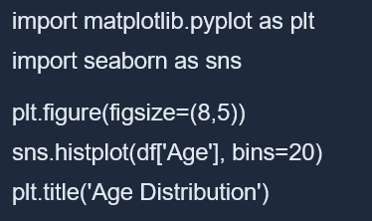
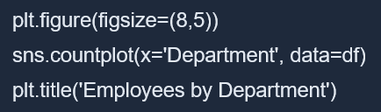
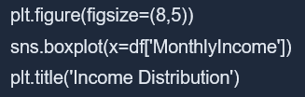
Live Demo: Univariate Plots
Histogram
Count Plot
Box Plot
Pro Tips:
Use kde=True in histplot for a smooth
curve Rotate x-labels if text overlaps
Add clear titles

Slide 20
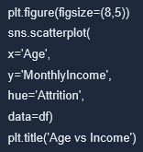
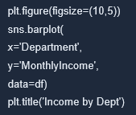
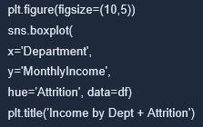
Live Demo: Bivariate Plots
Scatter Plot
Bar Chart
Grouped Box Plot
When to Use What:
Scatter: 2 numeric variables
Bar: Numeric vs categorical
hue= adds a 3rd dimension!

Slide 21
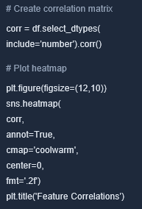
Live Demo: Correlation Heatmap
How to Read
1. Dark Red = Strong Positive (+1)
Observe both variables increasing together
2. White = No Correlation (0)
Identify no linear relationship
3. Dark Blue = Strong Negative (-1)
Note one increasing while the other decreases
Look for: Features highly correlated with target and features correlated with each other (redundancy)
Notes:
Reference image:
https://www.shutterstock.com/image-illustration/colored-heat-map-temperature-1176870094

Slide 22
Activity: Tell the Story with Charts
Time: 10 minutes
Create 3 Visualisations
Checklist
Age distribution by Attrition
Ensure each visualisation has:
Hint: histplot with hue='Attrition'
1. Add a clear title
2. Label axes
Attrition rate by Department
3. Include a legend (if using hue)
Hint: barplot or countplot
4. Share a business insight
Bonus: Save your best chart as an image!
plt.savefig('my_chart.png')
Correlation heatmap (top 10 features)
Hint: Select subset of columns first

Slide 23
Shape for Success
From Raw to Engineered

Slide 24
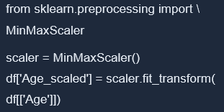
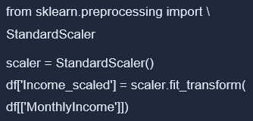
Live Demo: Feature Scaling
MinMax Scaling (0 to 1)
Standard Scaling (Z-score)
Use when: Need bounded range, neural networks, image data
Use when: Data has outliers, algorithms assume normal distribution
Fit the scaler on training data only, then transform both train and test

Slide 25
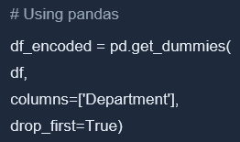
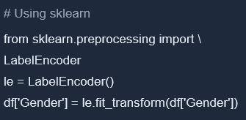
Live Demo: Encoding Categorical Variables
One-Hot Encoding
Label Encoding
Use when: No natural order (colors, departments)
Use when: Binary or ordinal categories
Creates: Dept_Sales, Dept_HR, Dept_IT...
Creates: Female=0, Male=1

Slide 26
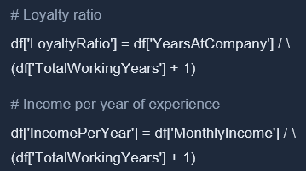
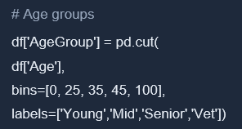
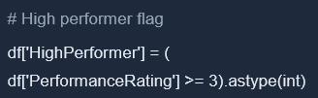
Live Demo: Creating New Features
Ratios and Combinations
Binning / Bucketing
Boolean Flags
Why Create Features?
Capture domain knowledge
Create meaningful combinations
Improve model performance

Slide 27
Activity: Engineer Your Features
Time: 10 minutes
Your Tasks
Bonus Challenge
Scale Monthly Income using Standard Scaler
Think of 2 creative features
What combinations might predict attrition?
One-hot encode Department column
Ideas: Promotion gap, over work score, career growth rate...
Create a new feature: Satisfaction Score = (Job Satisfaction + Environment Satisfaction) / 2
Pro Tip: Check correlation of new features with Attrition!
Create a Tenure Ratio feature

Slide 28
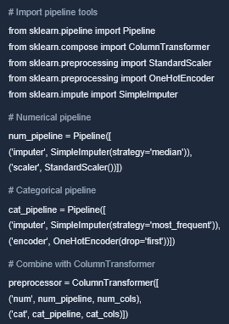
Building a Preprocessing Pipeline
Complete sklearn Pipeline for Reproducible Workflows
Why Use Pipelines?
Prevents Data Leakage
Fit transformations only on training data
Reproducible
Apply the same steps consistently every time
Production-Ready
Save and deploy the entire pipeline as one object
Cleaner Code
Chain multiple steps into single workflow

Slide 29
Ready to Predict
From preparation to ML

Slide 30

Train-Test Split: The Golden Rule
Why Splitting Matters for Honest Evaluation
The Rules
1. Never train on test data
Ensure the model never sees test data during training
2. Split Before transformations
FULL DATASET (100%)
Fit scalers and encoders on training data only
TRAINING SET
TEST SET
70-80%
20-30%
3. Use random_state for reproducibility
Model learns from this
Use the same split every time you run the code
Evaluate here
Notes:
https://www.shutterstock.com/image-photo/compliance-rule-law-regulation-graphic-interface-1767144422

Slide 31
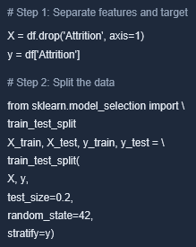
Live Demo: Proper Splitting
Key Parameters
test_size=0.2: Split 20% for testing and 80% for training
random_state=42: Ensure the same split every run (reproducible)
stratify=y: Maintain class balance in both sets
Verify: By printing (X_train.shape, X_test.shape)

Slide 32
Stratified Splitting for Imbalanced Data
Maintaining Class Distribution Across Splits
The Problem
Recognise the dataset has 20% attrition (imbalanced); random splitting might give train = 18% and test = 25%, causing the model to learn incorrect patterns
The Solution: Stratified Split
Use stratify=y to ensure both training and test sets have the same class distribution as the original data
Visual Comparison
Without stratify=y
With stratify=y
Train: 18%
Test: 25%
Train: 20%
Test: 20%
Uneven distribution!
Same as original!

Slide 33
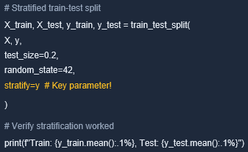
Stratified Splitting for Imbalanced Data (contd.)
Maintaining Class Distribution Across Splits
When to use stratified splitting
Apply this approach to classification tasks with imbalanced classes (fraud detection, disease diagnosis, churn prediction)

Slide 34

Cross-Validation
More Robust Model Evaluation
1. The Limitation of Single Split
5-Fold Cross-Validation
Recognise that one train–test split might be “lucky” or “unlucky”, as model performance depends on which data ends up in the test set
Fold 1:
Fold 2:
Fold 3:
Fold 4:
2. Cross-Validation Solution
Fold 5:
Split data into K folds, train on K–1 folds and test on the remaining fold. Repeat K times and average results for a reliable estimate
Train
Test

Slide 35


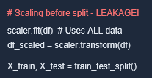
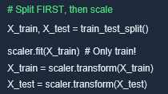
Data Leakage: What Not to Do
Common Mistakes That Ruin Your Model
Wrong
Correct
Problem: Scaler "sees" test data statistics during fit — information leaks from future to past!
Correct: Scaler learns only from training data, simulating real-world scenario!
Notes:
https://www.flaticon.com/free-icon/cross_18556540
https://www.flaticon.com/free-icon/check-mark_5291043

Slide 36

Complete Pipeline Summary
What You Built Today
Load
Assess
Clean
EDA
Split
Transform
Visualise
Have a complete, reusable preprocessing pipeline
Be ready for any ML project you tackle next

Slide 37
Challenges in Data and Feature Engineering

Slide 38
Key Challenges in Data Processing
Common Issues in Large-Scale Data Handling
Handling Large Datasets
Feature Selection and Dimensionality Reduction
Data Quality Issues
Feature Overlap: Removing redundant features while retaining important ones is challenging
Missing Values: Incomplete data can lead to biased models and inaccurate predictions
Scalability: Processing large volumes of data requires efficient techniques
Computational Complexity: High-dimensional data increases computation time and resource demands
Balancing Dimensionality: Reducing data complexity while preserving critical information is essential
Noise and Errors: Irrelevant or incorrect data can distort results
Notes:
Data Quality Issues:
Missing Values: Incomplete data can lead to biased models and inaccurate predictions.
Noise and Errors: Inaccurate or irrelevant data can distort model training and results.
Handling Large Datasets:
Scalability: Processing and managing large volumes of data require efficient techniques and resources.
Computational Complexity: High-dimensional data can lead to increased computation time and resource demands.
Feature Selection and Dimensionality Reduction:
Feature Overlap: Identifying and removing redundant features while retaining important ones can be challenging.
Balancing Dimensionality: Reducing dimensionality without losing critical information requires careful consideration.

Slide 39
Key Challenges in Data Processing(Contd.)
Common Issues in Large-Scale Data Handling
Feature Engineering Complexity
Dealing with Diverse Data Types
Model Overfitting and Underfitting
Creating Meaningful Features: Designing features that capture patterns and relationships is complex
Mixed Data Types: Integrating structured, semi-structured and unstructured data is challenging
Overfitting: Complex features may cause models to perform well on training data but poorly on new data
Automating Feature Engineering: Developing automated processes requires advanced techniques
Encoding and Normalisation: Proper encoding and normalising of numerical features is crucial
Underfitting: Poorly engineered features may lead to models that fail to capture patterns
Notes:
Feature Engineering Complexity:
Creating Meaningful Features: Designing features that effectively capture the underlying patterns and relationships in the data can be complex.
Automating Feature Engineering: Developing automated processes for feature engineering can be challenging and require advanced techniques.
Dealing with Diverse Data Types:
Mixed Data Types: Integrating and processing structured, semi-structured and unstructured data can be complex.
Encoding and Normalization: Properly encoding categorical variables and normalizing numerical features are crucial for effective modeling.
Model Overfitting and Underfitting:
Overfitting: Complex features may lead to models that perform well on training data but poorly on unseen data.
Underfitting: Insufficient or poorly engineered features can lead to models that fail to capture the data’s patterns.

Slide 40
Strategies to Overcome Data Challenges
Best Practices for Data Quality, Processing and Feature Engineering
Category | Strategy | Description
Improve Data Quality | Apply imputation techniques | Fill missing values using advanced methods
 | Perform data cleaning | Remove noise and errors for reliable results
Enhance Processing Efficiency | Use big data technologies | Use tools like Hadoop and Spark for large datasets
 | Apply dimensionality reduction | Apply PCA, t-SNE or LDA for high-dimensional data
Notes:
Data Quality Improvement:
Imputation Techniques: Use advanced imputation methods to handle missing values.
Data Cleaning: Implement robust data cleaning procedures to address noise and errors.
Efficient Processing:
Big Data Technologies: Utilize tools and frameworks like Hadoop and Spark for handling large datasets.
Dimensionality Reduction Techniques: Apply PCA, t-SNE or LDA to manage high-dimensional data.
Effective Feature Engineering:
Feature Selection Methods: Use techniques like filter methods, wrapper methods and embedded methods for feature selection.
Automated Tools: Explore automated feature engineering tools and frameworks.
Handling Diverse Data:
Unified Data Handling: Develop strategies to integrate and process different data types seamlessly.
Proper Encoding: Apply appropriate encoding methods for categorical variables and normalization for numerical features.

Slide 41
Strategies to Overcome Data Challenges
Best Practices for Data Quality, Processing and Feature Engineering
Category | Strategy | Description
Optimise feature engineering | Perform feature selection | Use filter, wrapper and embedded methods
 | Use automated tools | Leverage AI-driven feature engineering frameworks
Handle diverse data | Unify data handling | Integrate and process different data types seamlessly
 | Apply proper encoding | Apply standard encoding and normalisation for accuracy
Notes:
Data Quality Improvement:
Imputation Techniques: Use advanced imputation methods to handle missing values.
Data Cleaning: Implement robust data cleaning procedures to address noise and errors.
Efficient Processing:
Big Data Technologies: Utilize tools and frameworks like Hadoop and Spark for handling large datasets.
Dimensionality Reduction Techniques: Apply PCA, t-SNE or LDA to manage high-dimensional data.
Effective Feature Engineering:
Feature Selection Methods: Use techniques like filter methods, wrapper methods and embedded methods for feature selection.
Automated Tools: Explore automated feature engineering tools and frameworks.
Handling Diverse Data:
Unified Data Handling: Develop strategies to integrate and process different data types seamlessly.
Proper Encoding: Apply appropriate encoding methods for categorical variables and normalization for numerical features.

Slide 42






Key Takeaways
Remember These for Your ML Journey
Data Quality First: Assess and clean your data before modelling; garbage in = garbage out
Feature Engineering Matters: Scaling, encoding and creating features can dramatically improve model performance
EDA is Not Optional: Understand your data through exploration to reveal patterns that inform feature engineering
Prevent Data Leakage: Split before transforming; fit on training data and transform on both
Visualise to Communicate: Use charts to turn numbers into stories; choose the right plot for your question
Practice Makes Perfect: Apply this workflow to different datasets; each one teaches something new
Notes:
https://www.flaticon.com/free-icon/database_9542733
https://www.flaticon.com/free-icon/engineering_3002128
https://www.flaticon.com/free-icon/communication_2575636
https://www.flaticon.com/free-icon/connection_4269808
https://www.flaticon.com/free-icon/folder_1975660

Slide 43
What's Next?
Your Learning Journey Continues
Coming Up in This Course
To Reinforce Today's Learning
Supervised Learning
  Explore classification and regression algorithms
Practice Assignment
  Apply today’s pipeline to a new dataset; try the Titanic or House Prices dataset on Kaggle
Unsupervised Learning
  Perform clustering and pattern discovery
Review Materials
  Revisit the async content and experiment with different cleaning and feature engineering techniques
Model Evaluation
  Evaluate metrics, cross-validation and tuning
Notes:
Reference Image :
https://www.shutterstock.com/image-photo/online-documentation-database-document-management-system-2141549661

Slide 44
Q & A

Slide 45
Thank you

